Slide 1
Enhancing E-Resource Management: Novel Technologies and New Methodological Approaches
Cathy Austin, MSIS, cgd67@msstate.edu Interim Director for Resource Management Mississippi State University Libraries
Ray Uzwyshyn, Ph.D. MBA MLIS, rju13@mstate.edu Associate Dean for Collection Management & Strategy Mississippi State University Libraries

Slide 2
MSU Collections Budget Strategy MSU libraries are utilizing Open Access high quality academic e-resources, CloudSource+ and Article Galaxy Scholar to leverage current holdings towards larger budget savings and new open access possibilities

Slide 3
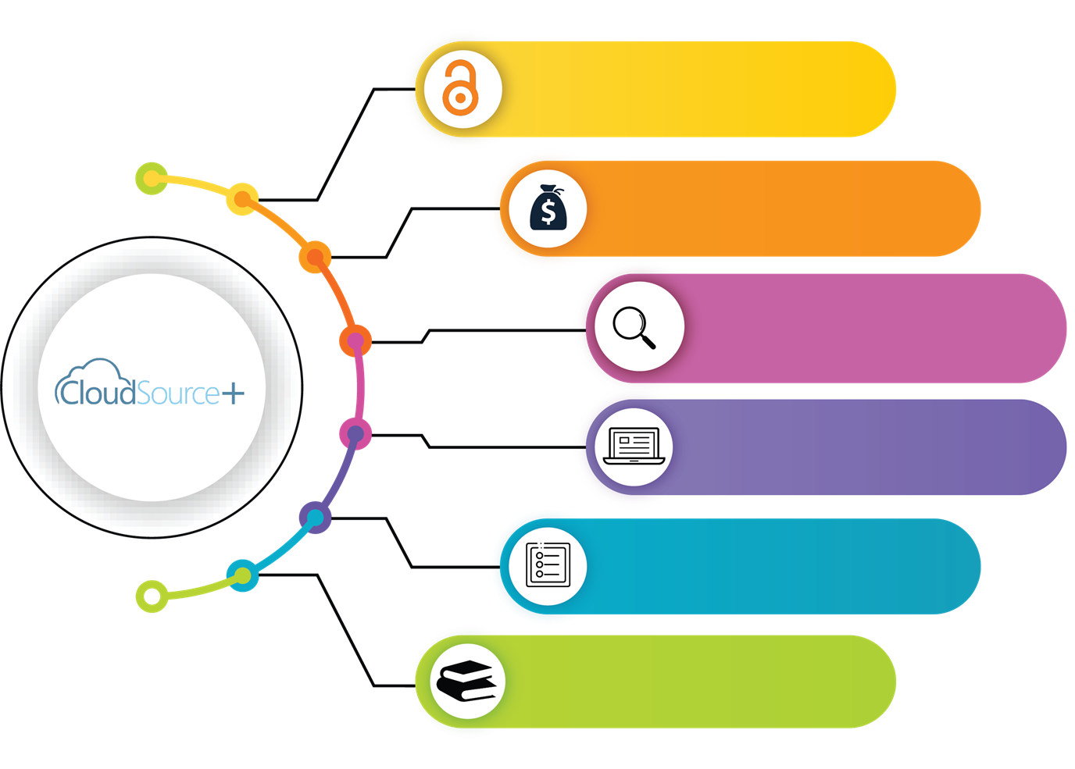
Present Library Journal Subscriptions
Leverages
Open Access Savings
60 Million high quality OA scholarly resources
48 Million Open Access Articles (100K Journals)
High Quality Indexes
Support for OER & Open Textbooks

Slide 4
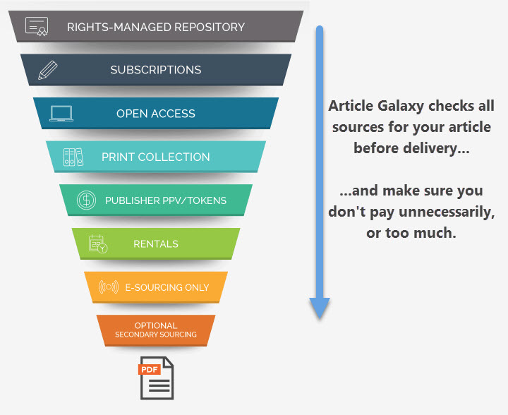
Article Galaxy Scholar Budget Efficient and Focused Journal/Article Backup Source​

Slide 5
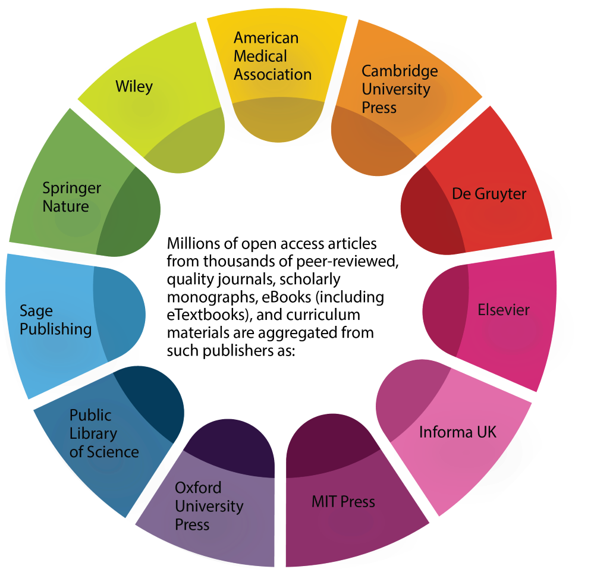
Aggregates Content from High Quality Publishers
Large Cost/Benefit Strategy
Allows purchase of focused Journal/Articles not Available

Slide 6
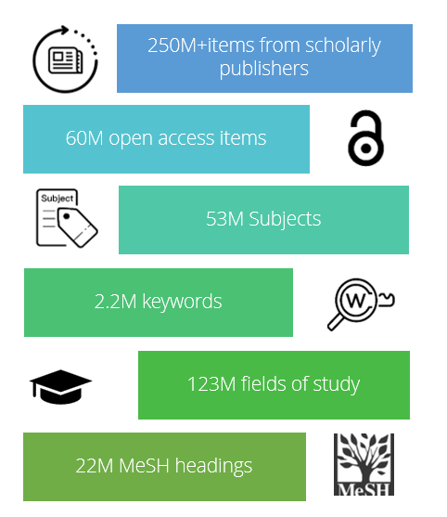
MSU Open Access Research Collections Budgetary Strategy
The libraries are utilizing: CloudSource+ and Article Galaxy Scholar along with
Quantitative, Qualitative Data collection and overlap analysis as metrics to aid in better data-informed Budgetary decision making

Slide 7
Goals for E-Resources Subscriptions Evaluation Process
Create cost savings for library budget while maintaining access to scholarly journals and resources
Leverage open access and document delivery services

Slide 8
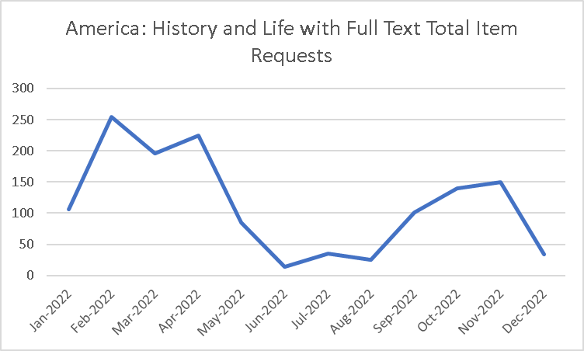
Quantitative Analysis
Quantitative evaluation metrics:
Downloads
Searches
Investigations
Site visits
Unique site visitors

Slide 9
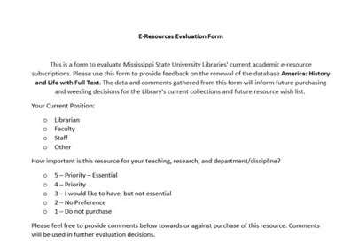
Qualitative Analysis
Qualitative Feedback from Stakeholders:
Department Heads
Faculty
Graduate Students

Slide 10
Qualitative Analysis
Have you or MSU published in journals included in this resource, or do you plan to submit or publish here in the future?
How many times have you used or referenced this resource in the past year for research or classes?

Slide 11
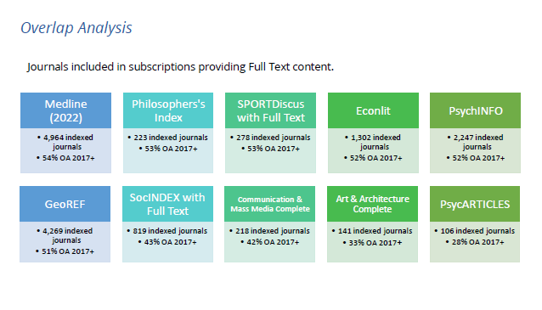
Cloudsource+ Open Access Overlap Analysis
The overlap analysis showed that many of our paid subscriptions contained as much as 50 % open access content.

Slide 12
Thank you!
Questions?
Contact us:
Caustin@library.msstate.edu
Ruzwyshyn@library.msstate.edu

